Slide 1
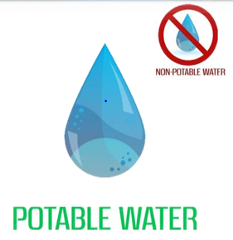
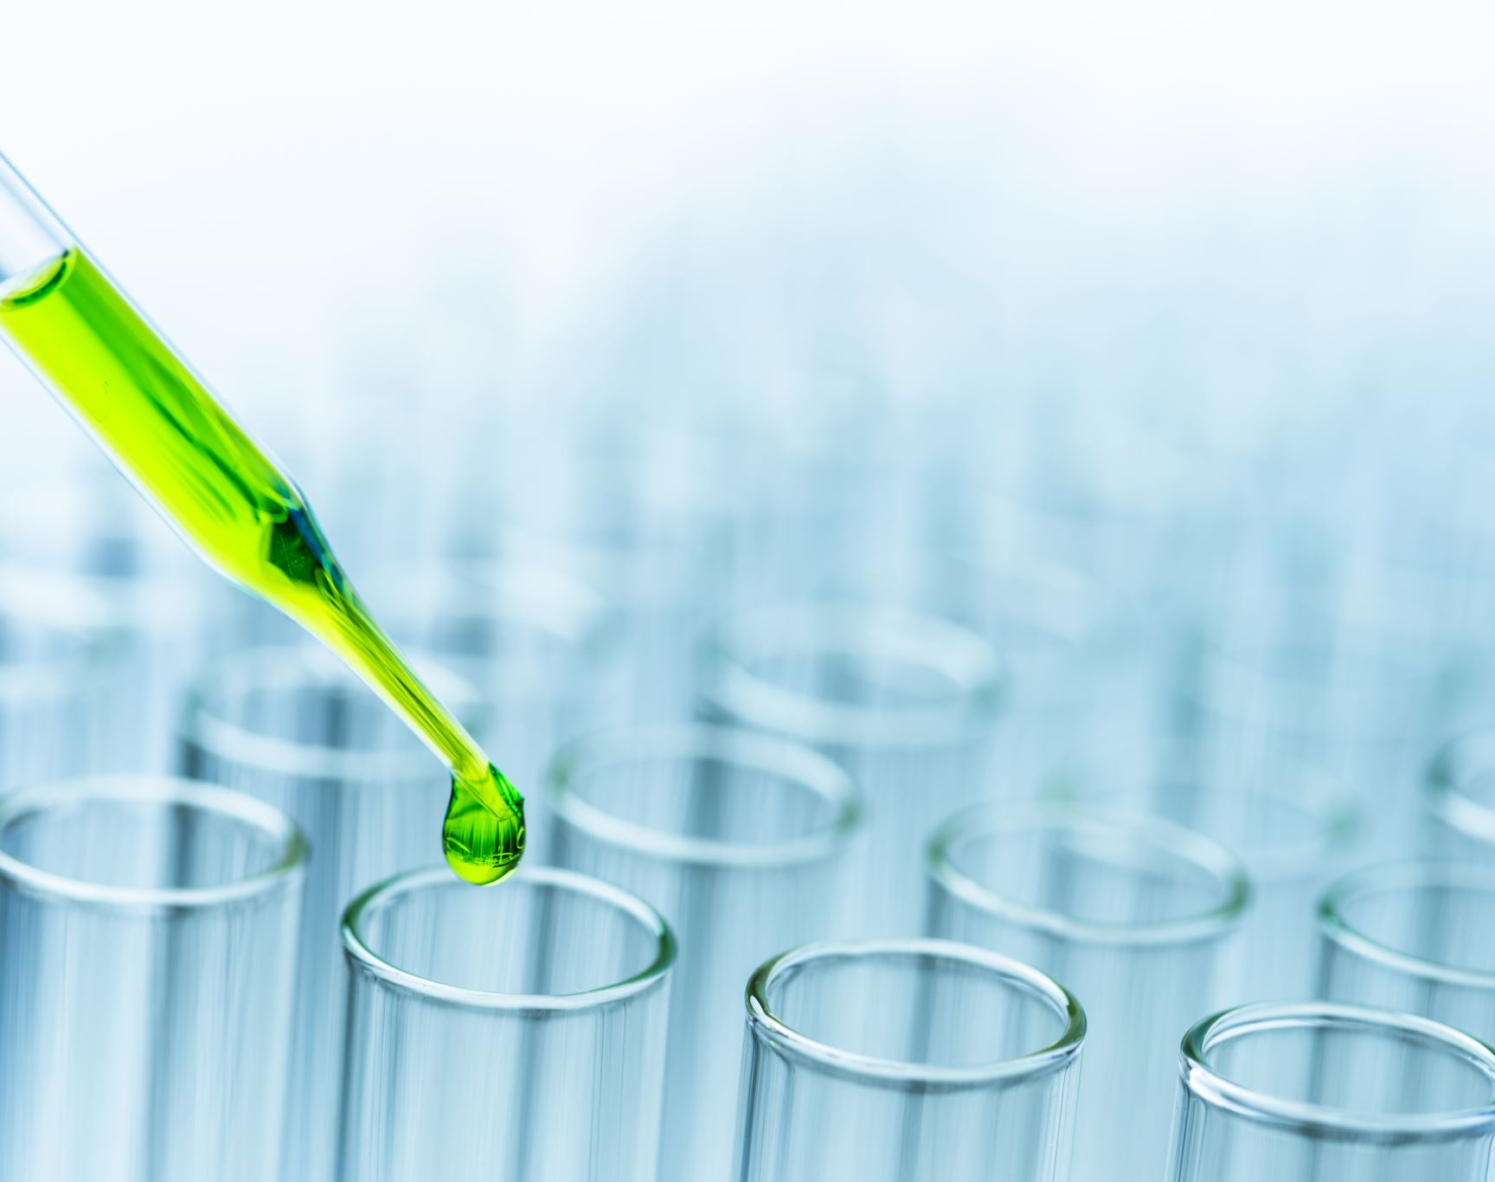
POTABILITY TEST OF WATER
By –Aakash Wakchaure
Batch -PGA46

Slide 2
Introduction
Water is an inorganic compound with the chemical formula H2O.
Potable water, also known as drinking water, comes from surface and ground sources.
Non-potable water is not suitable for drinking.
Microbiologically contaminated drinking water can transmit diseases such as diarrhea, cholera, dysentery, typhoid, and polio and is estimated to cause 4,85,000 diarrhea deaths each year. (According to WHO)

Slide 3
Objective
"Developing A Model To Predict The Potability Of Water Based On Various Parameters Such As Ph Level, Hardness, Turbidity, Solid(TDS), Chloramines, Organic carbon ,Trihalomethane ,Conductivity ,Sulphate and Potability ."

Slide 4
Data Description
Parameters | Description | Unit
pH | Measure of acidity or alkaline of water. | Range (0-14)
Organic carbon | Amount of carbon that present in water in an organic form. | mg/L
Solids | "Dissolved Solids" refer to any minerals, salts, metals, cations, anions dissolved in water | mg/L
Turbidity | The measure of relative clarity of a liquid. | NTU
Trihalomethanes | A byproduct of the water treatment process. | µg/L
Sulfate | A substance that occurs naturally in drinking water. | mg/L
Hardness | Presence of salts of calcium and magnesium. | mg/L

Slide 5
Parameters | Description | Unit
Chloramines | Disinfectants used to treat drinking water. | ppm
Conductivity | A measure of ability of water to pass an electrical current. | µS/cm
Potability | It refers to the suitability of water for human consumption. (1- Potable , 0 – Not Potable). | -

Slide 6
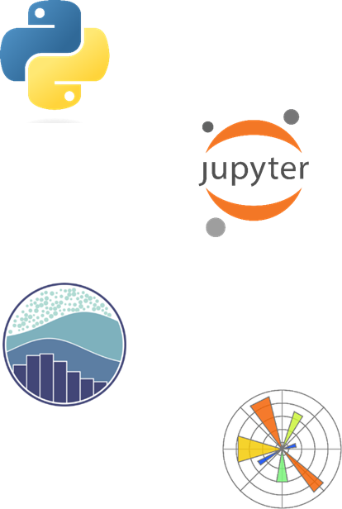
Tools & Platform
Tools: Python
Platform : Jupyter Notebook
Library Used: NumPy, pandas, Matplotlib,
Seaborn, Scikit-Learn.

Slide 7
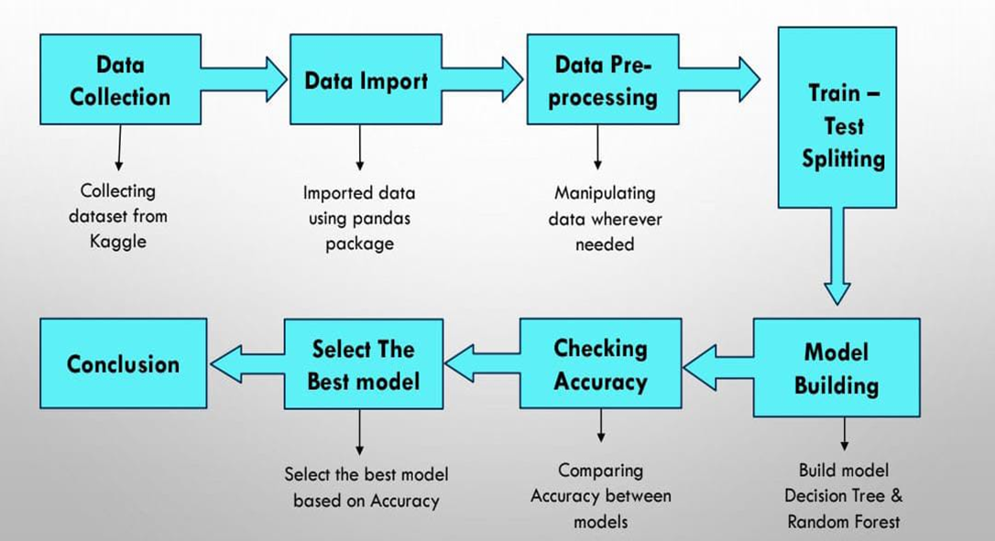
Process Flow

Slide 8
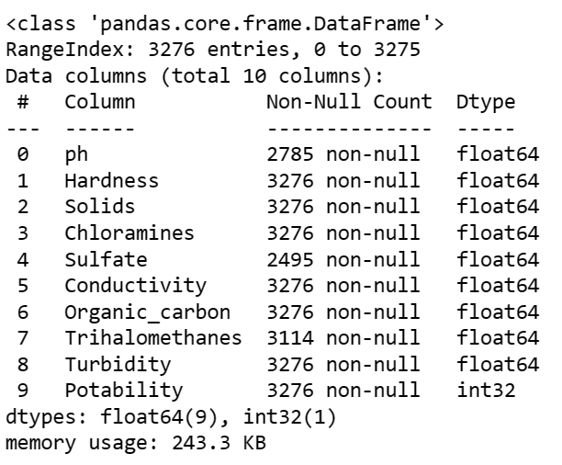
Data Processing

Slide 9
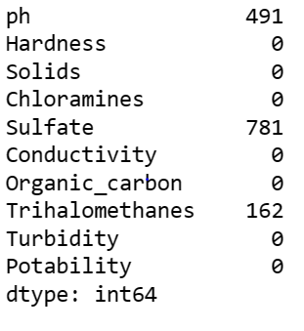
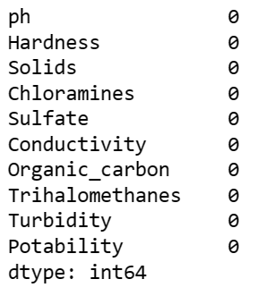
Identifying & Treatment of missing value
Replacing missing value by mean

Slide 10
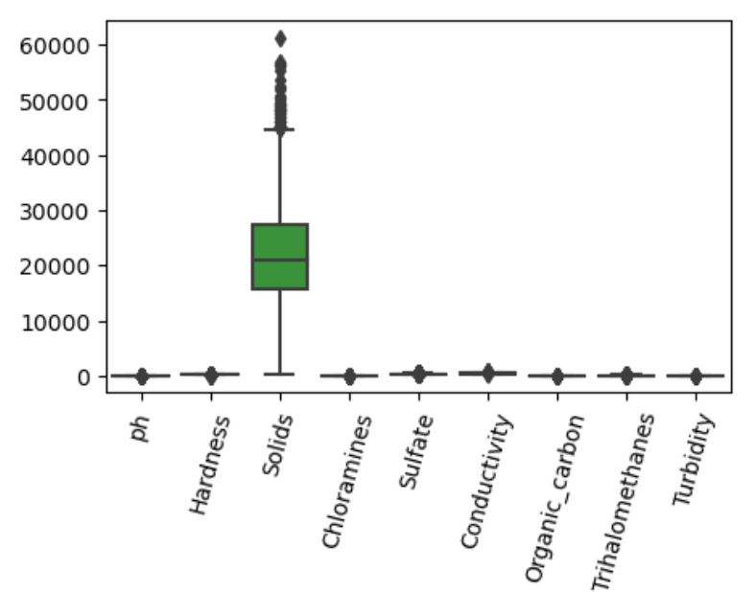
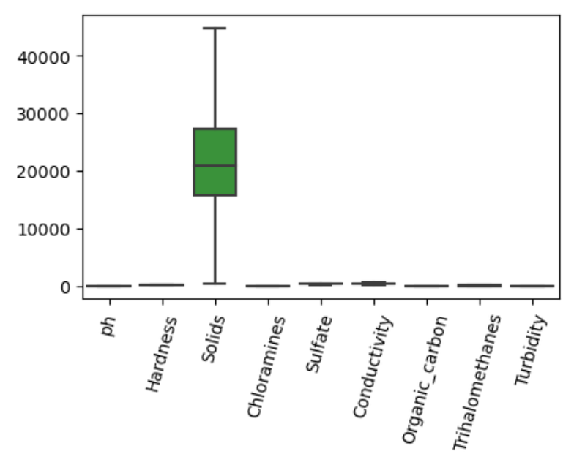
Identifying & Treatment of Outlier
Treat Outliers using
winsorizing Technique

Slide 11
Sampling :Divide data into Train & Test
.
Dataset
Train (70%)
Test (30%)

Slide 12
Model Building
Model
Model
Logistic
Regression
Decision
Tree
Random
Forest
SVM
KNN
Train Accuracy
60%
Test Accuracy
62%
100%
Accuracy
Train Accuracy
72%
Test
Accuracy
65%
Train Accuracy
61%
Test
Accuracy
62%
Train Accuracy
60%
Test
Accuracy
60%
After Pruning
Train Accuracy
80%
Test Accuracy
60%

Slide 13
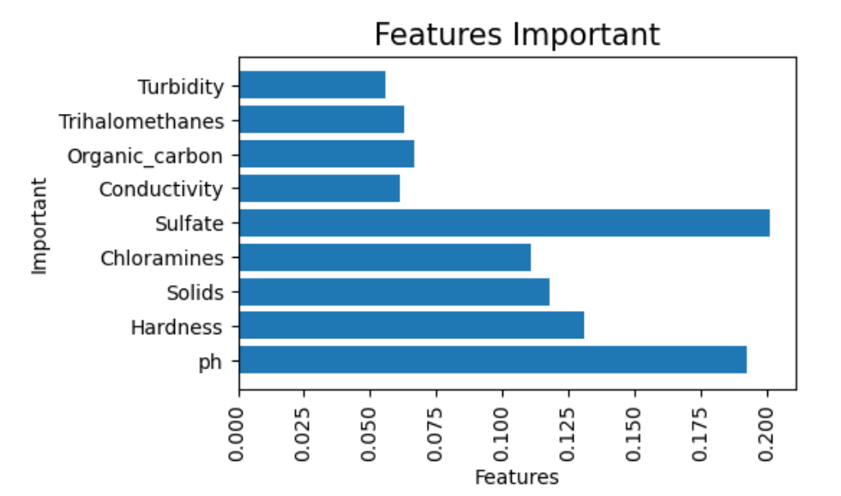
Important Features

Slide 14
Model Selection
Model Selection
Underfitting
Good Fitting
Overfitting
0
0.7
0.9
1

Slide 15
Sr. No. | Model | Accuracy Train | Accuracy Test
1 | Logistic Regression | 60% | 62%
2 | Decision Tree | 80% | 60%
3 | Random Forest | 72% | 65%
4 | SVM(Support Vector Machine) | 61% | 62%
5 | KNN(K-Nearest Neighbour) | 60% | 60%
Here we select Random forest as best model with high accuracy.

Slide 16
Conclusion
The important variable in our dataset is Ph, Sulfate, Chloramines, Solids.
Water with Ph value 6.4-8.5, Sulfate content 250- 500Mg/L, Chloramines content 4Ppm, Solids(tds) 500=100Mg/L is Drinkable Water(Potable Water).
Various methods to treat water are:-
1)Filtration
2)Disinfection
3)Filtration.

Slide 17
Thank You!

